Slide 1



Slide 2


Slide 3
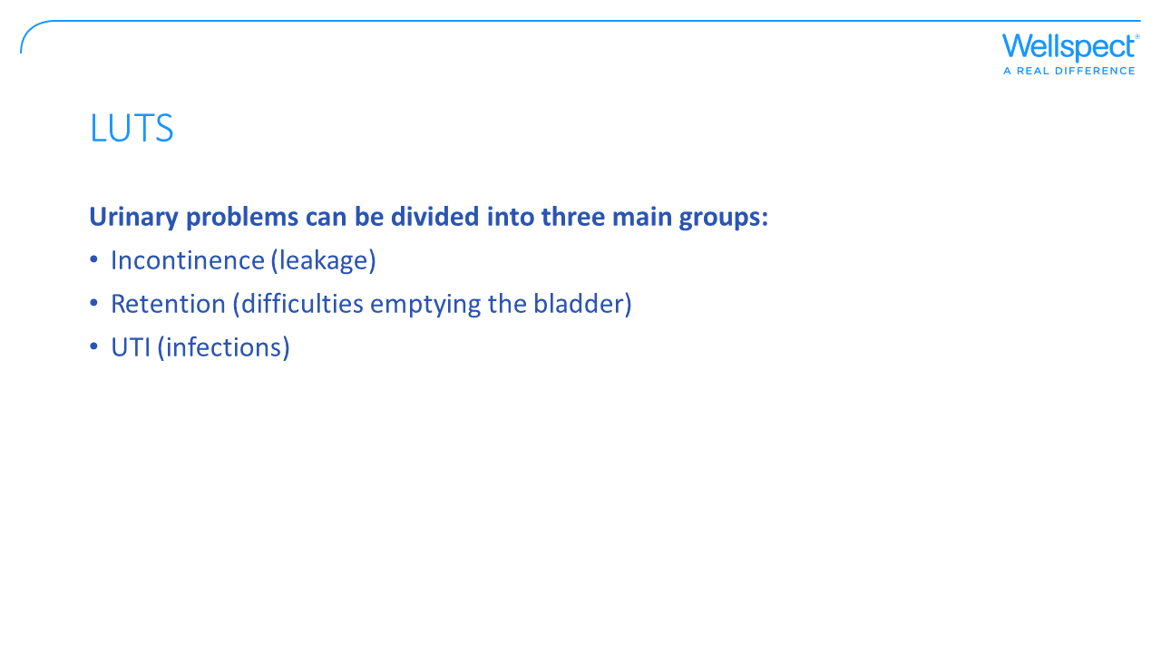
Notes:
Incontinence – prevalence
Retention – obstructive symptoms, hesitancy, poor stream, straining, incomplete emptying
UTI

Slide 4
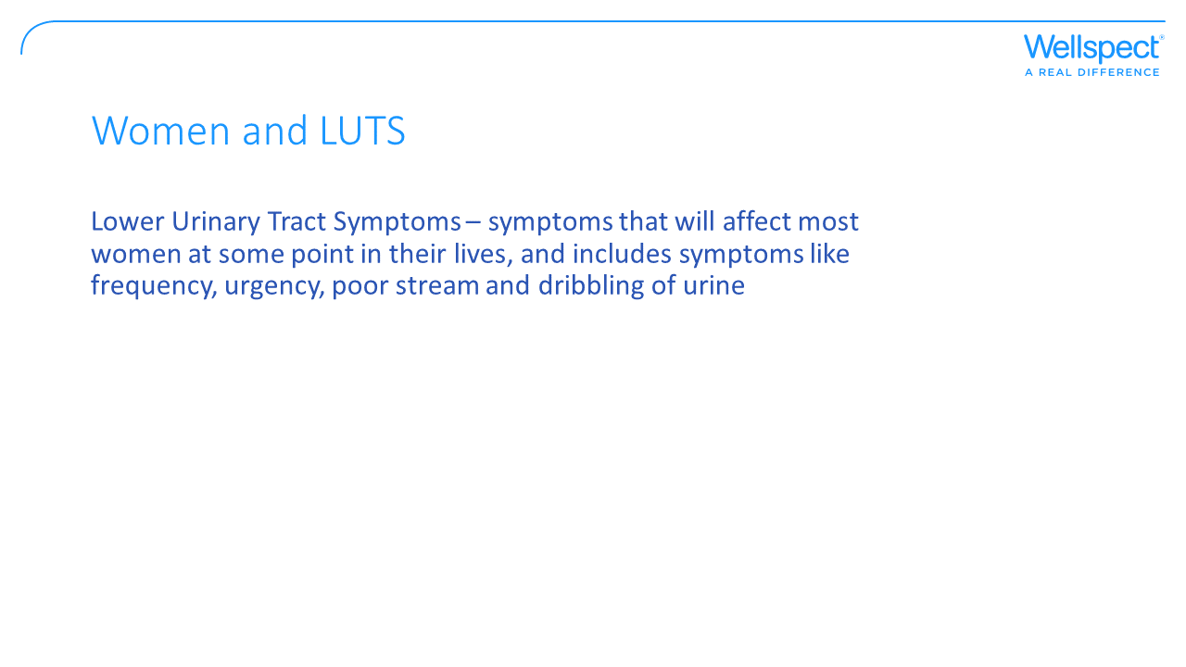
Notes:
Stress incontinence. Urgency. Key in door bladder…..desperate!

Slide 5

Notes:
Poor ladies!

Slide 6
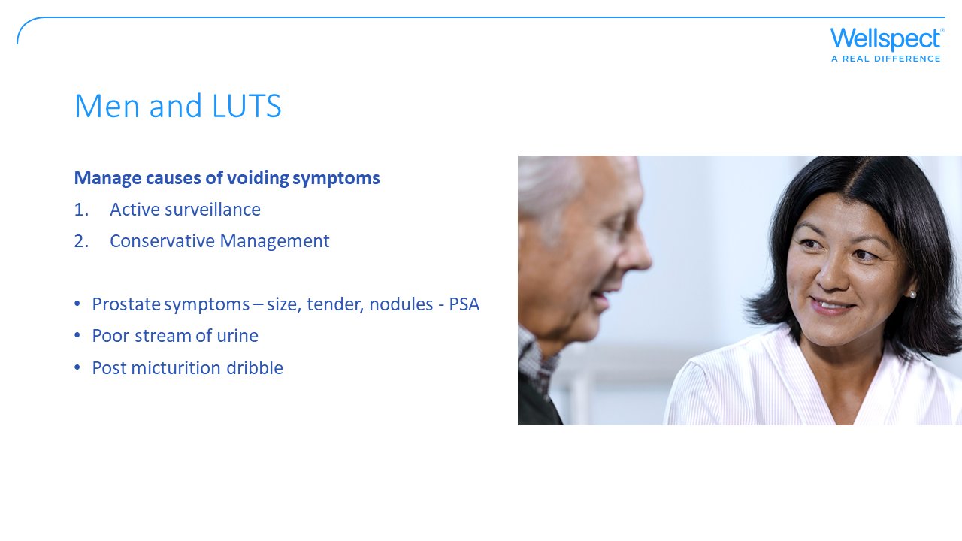
Notes:
Prostate more common 65+
Hesitancy, intermittent flow and straining

Slide 7


Slide 8
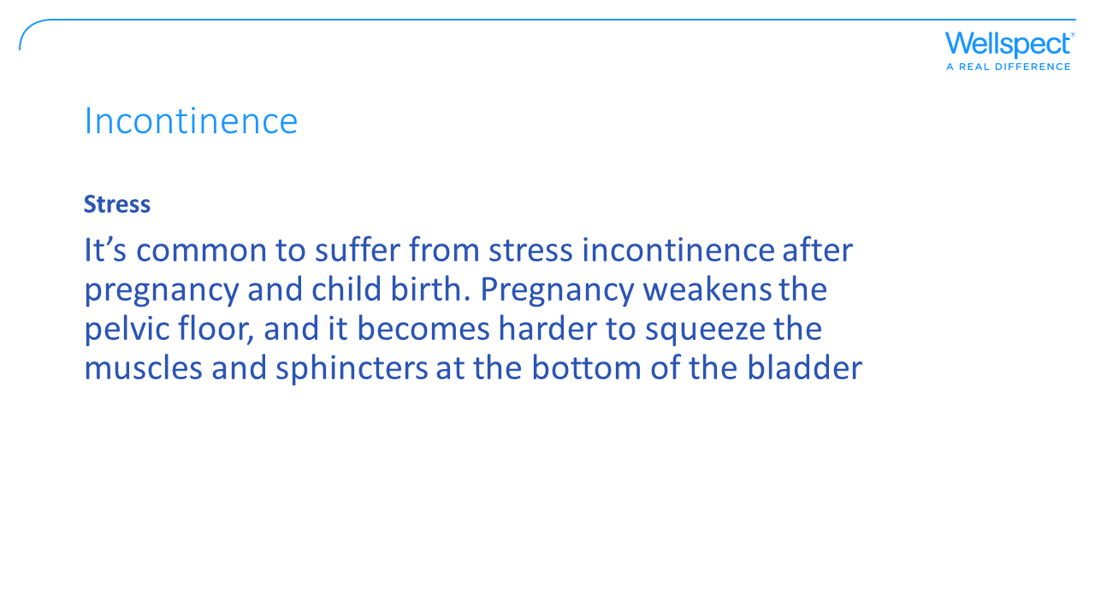

Slide 9
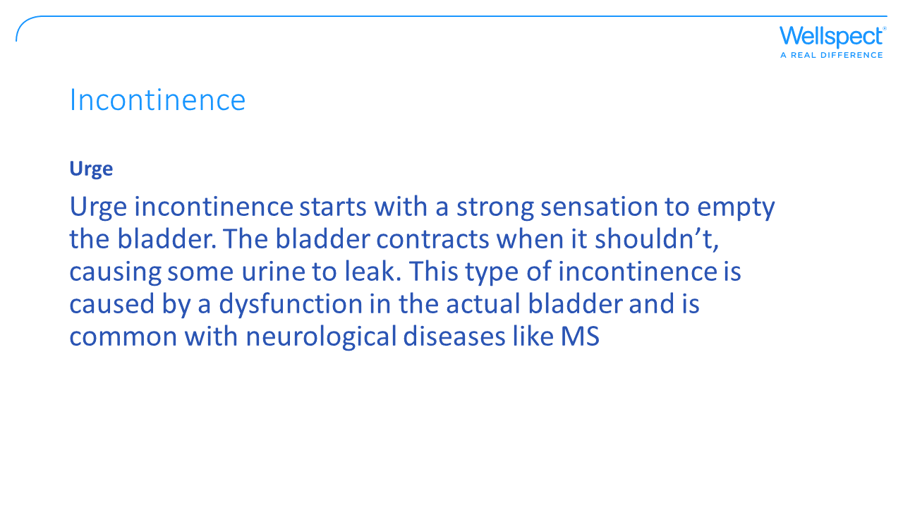

Slide 10
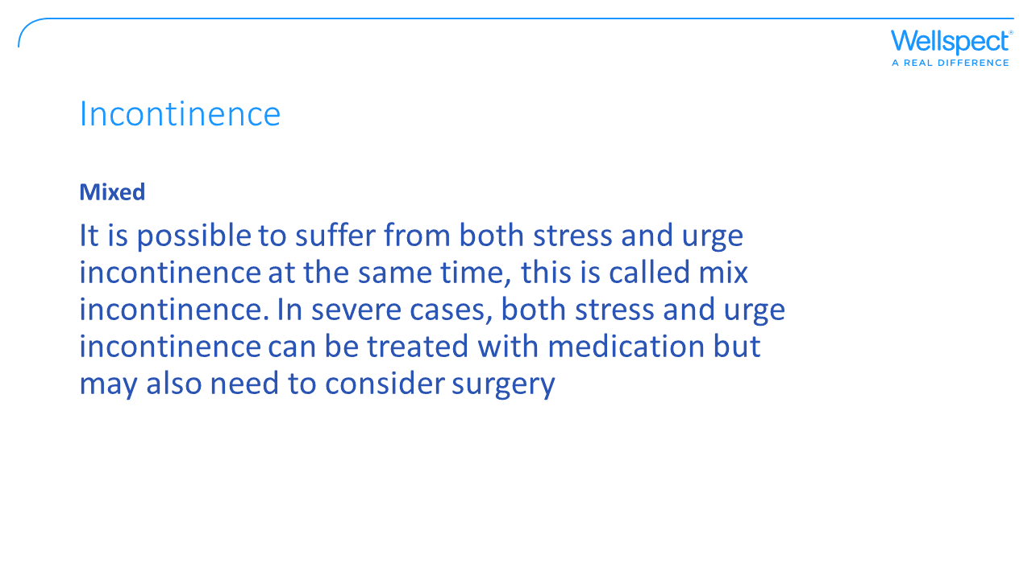
Notes:
Botox options

Slide 11
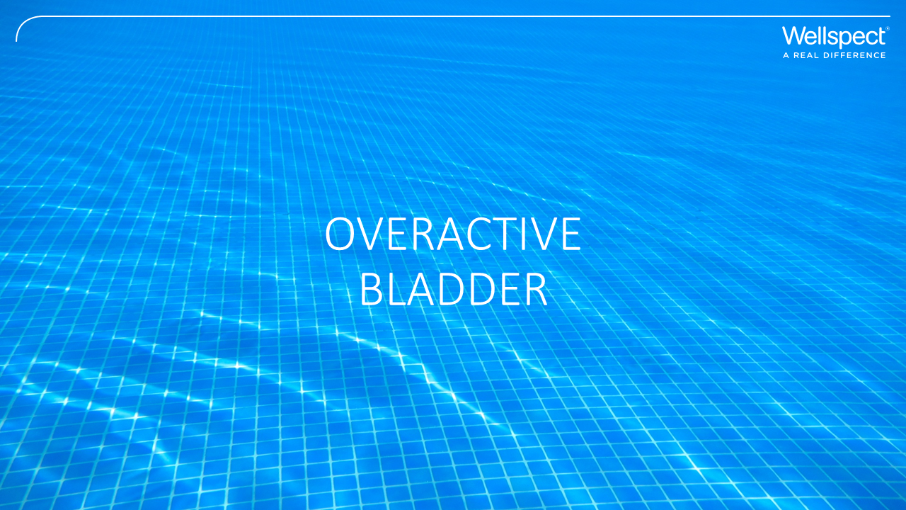

Slide 12
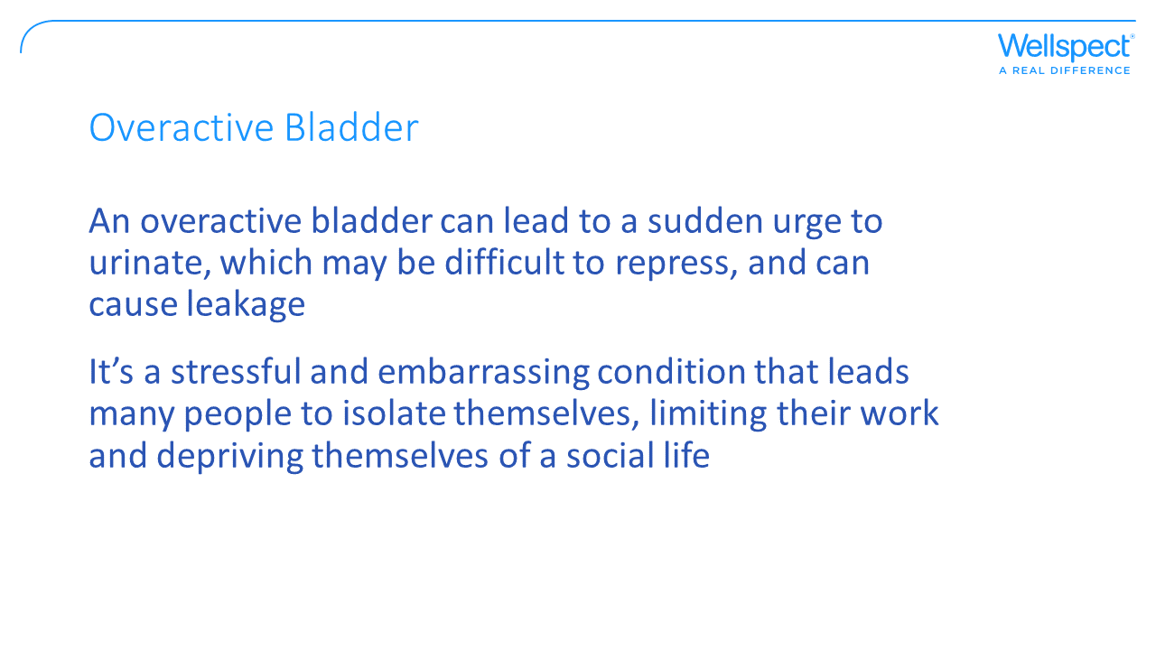
Notes:
Group of symptoms. Urgency. Nocturnal enuresis.
Treatments available
Medications: Anticholinergic
Bladder instillations
Botox

Slide 13
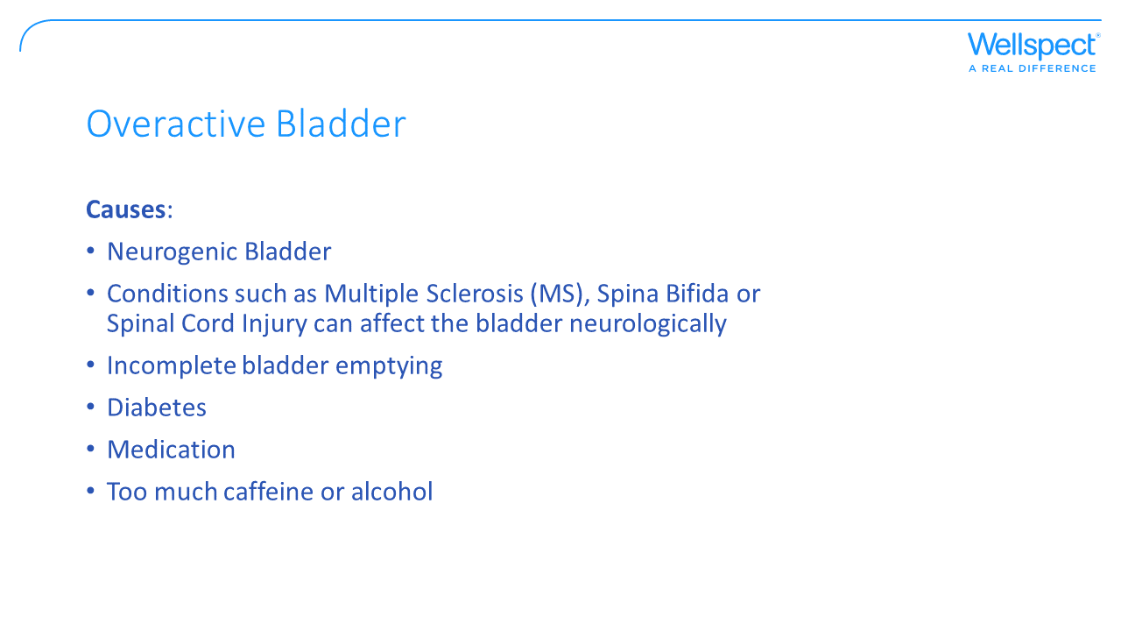
Notes:
Men 40+

Slide 14
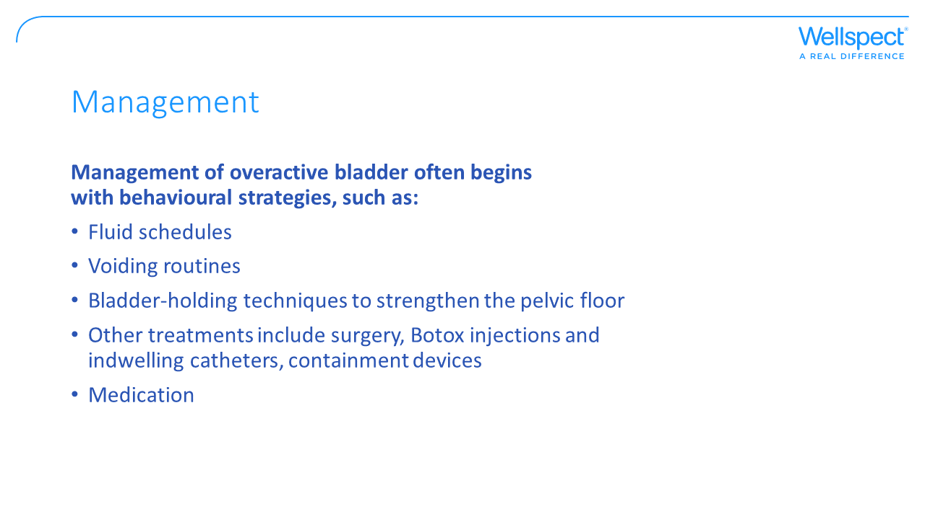
Notes:
Urinalysis – infection / blood
Bloods for glucose exclude diabetes. Men PSA

Slide 15
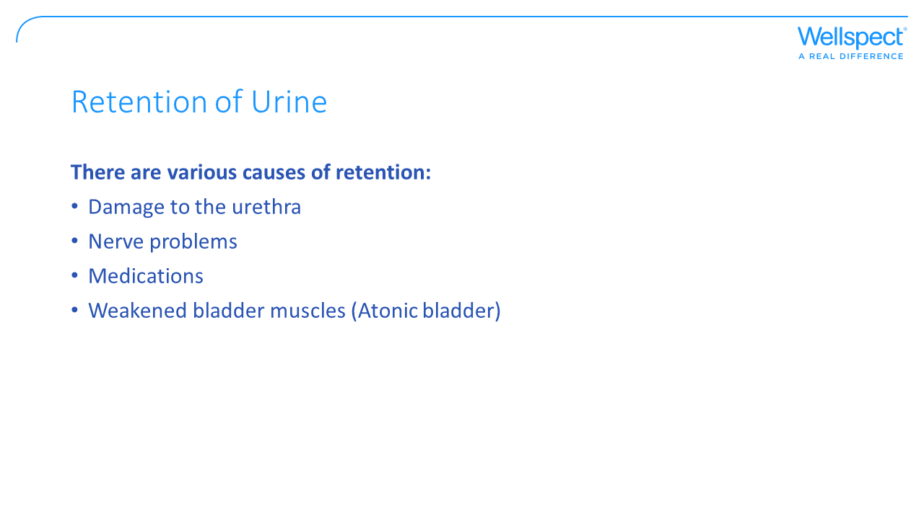

Slide 16
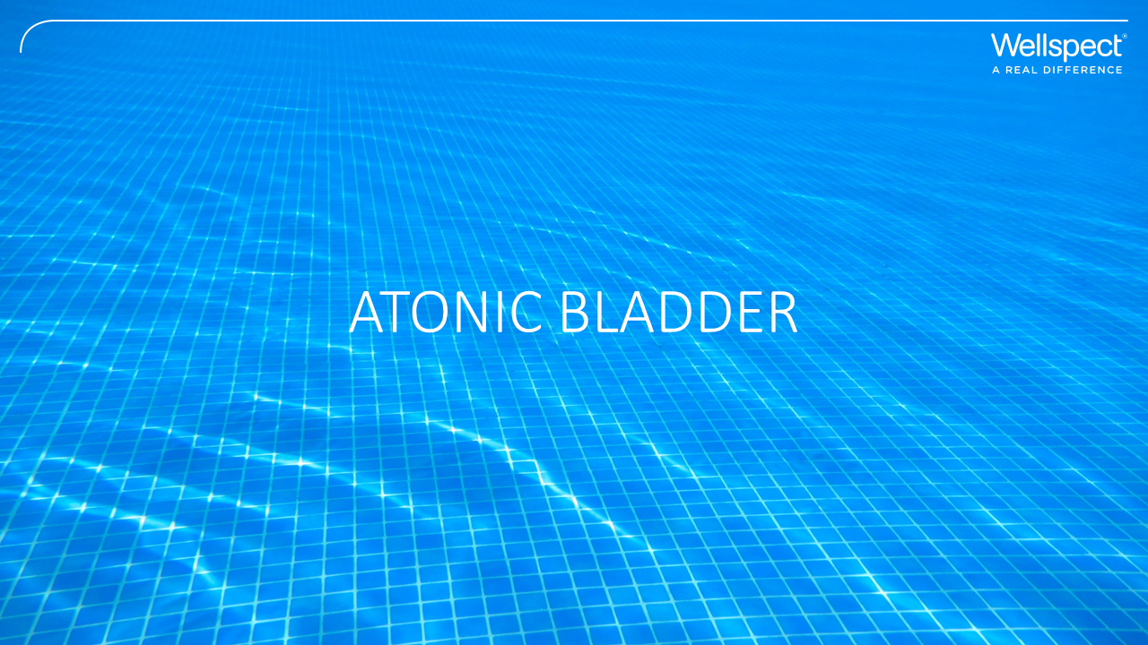

Slide 17
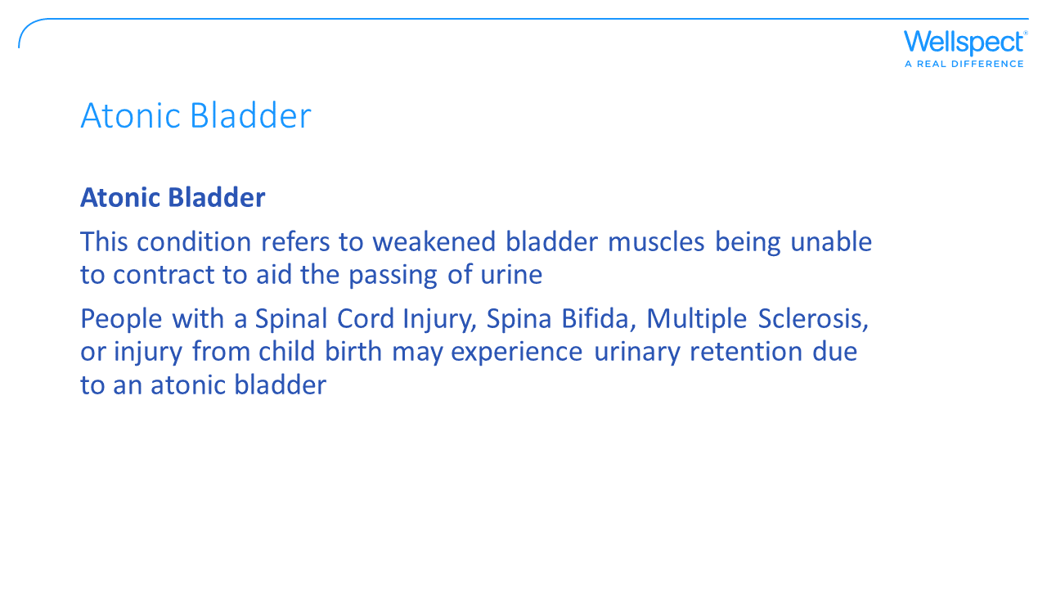

Slide 18
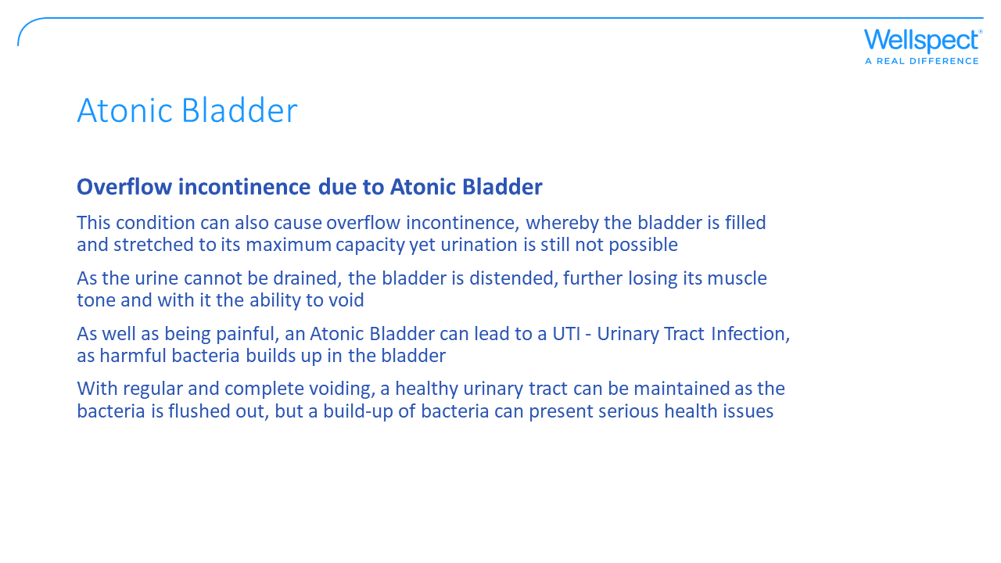

Slide 19
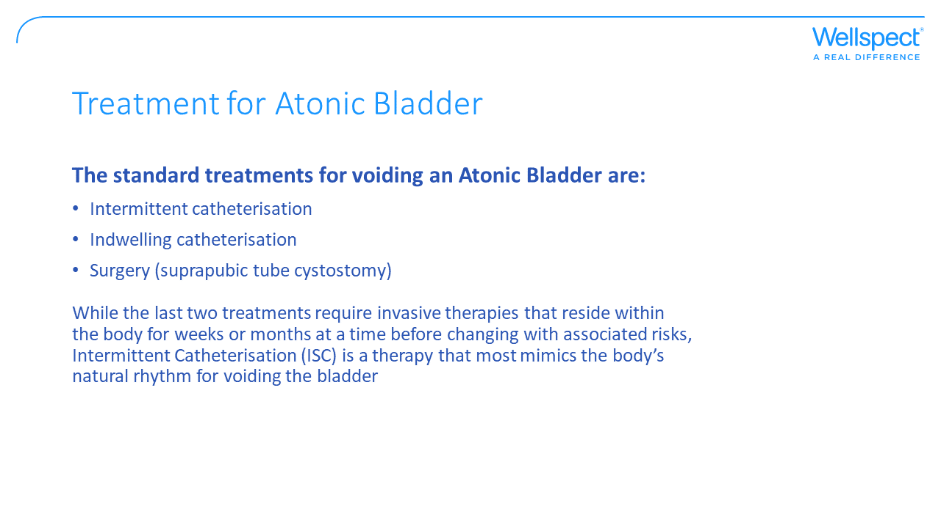
Notes:
We will look investigations later in training program
ISC Lofric.

Slide 20


Slide 21
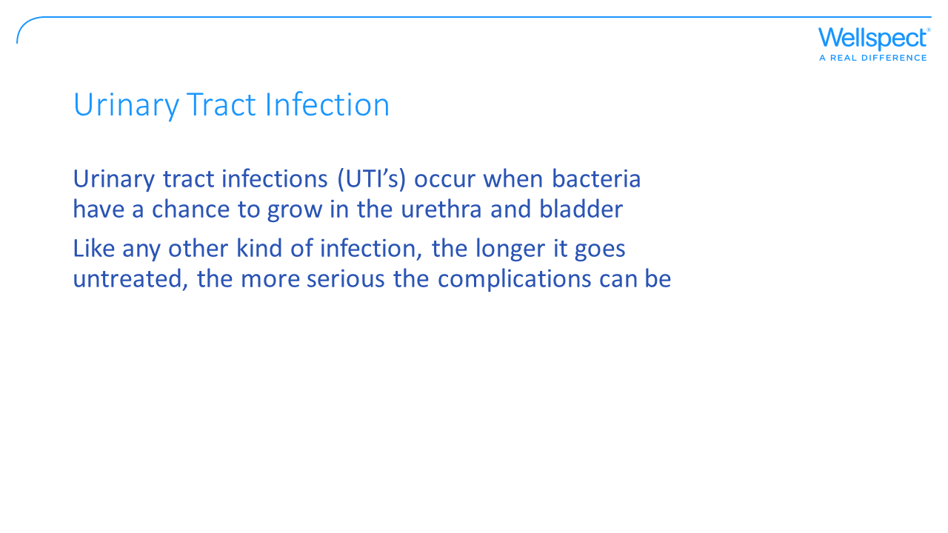

Slide 22
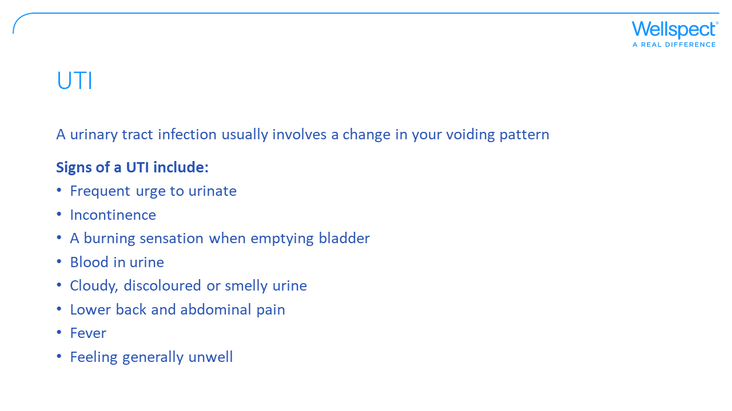
Notes:
People die from UTI’s

Slide 23
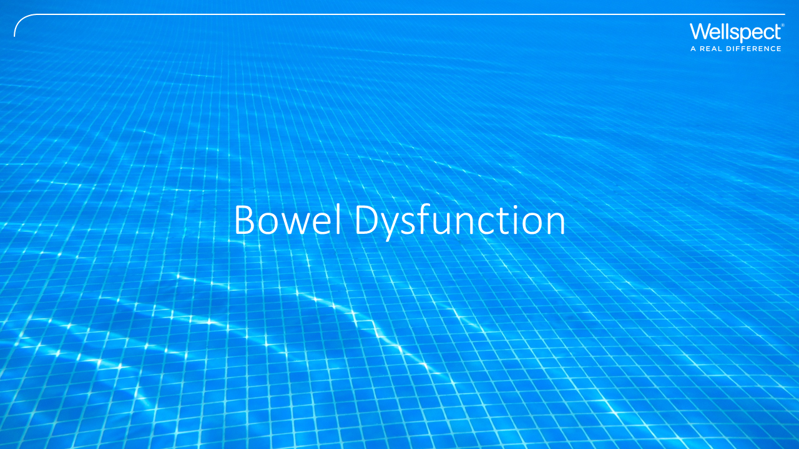

Slide 24
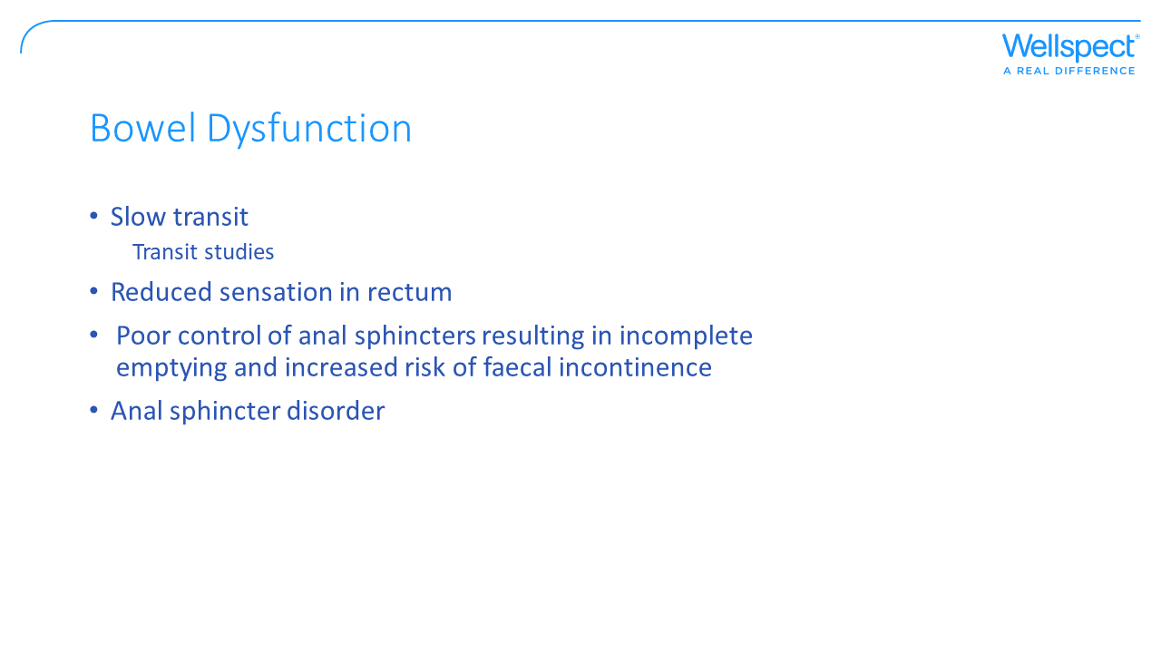
Notes:
Neurogenic and functional bowel …..symptoms
Sweetcorn test!

Slide 25
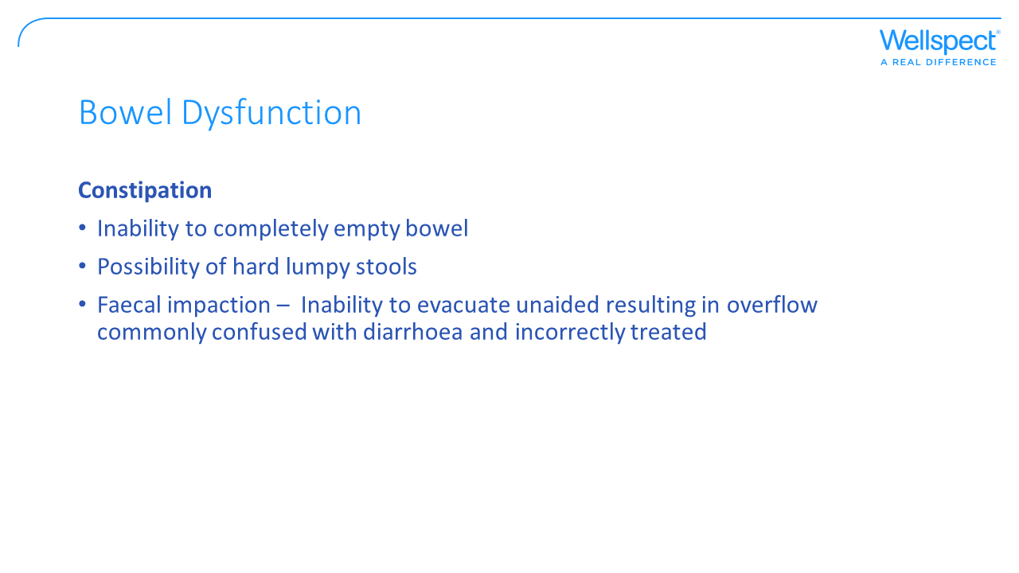

Slide 26
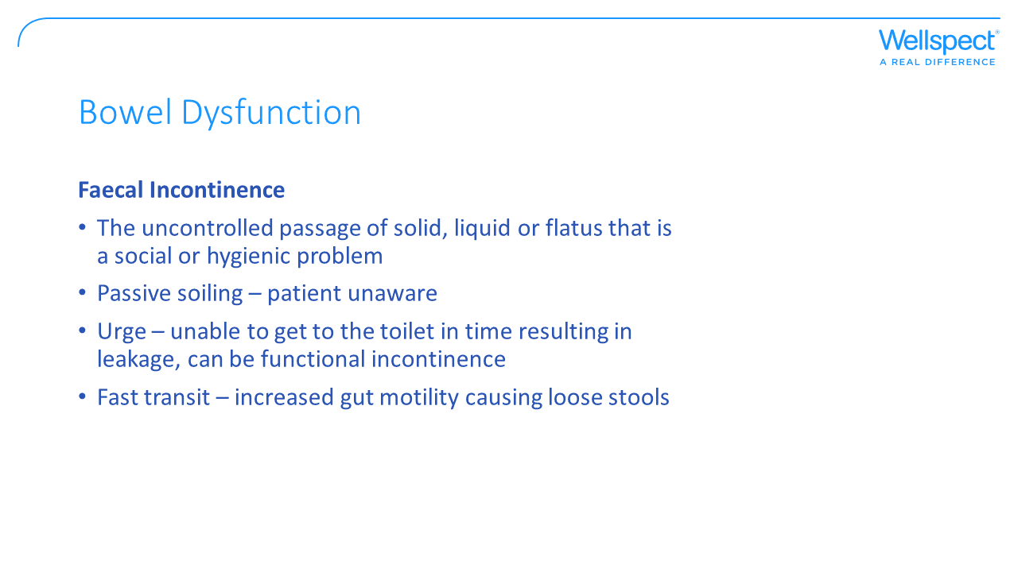

Slide 27
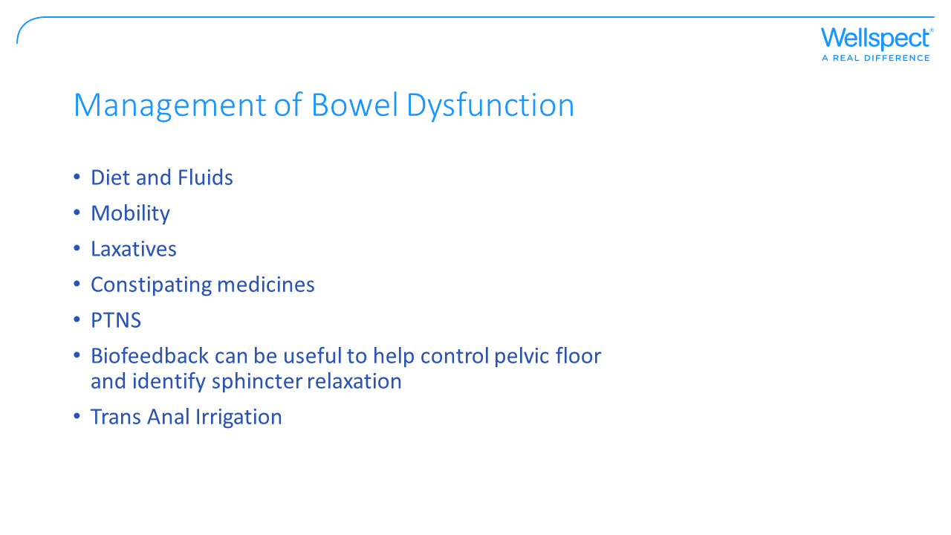

Slide 28
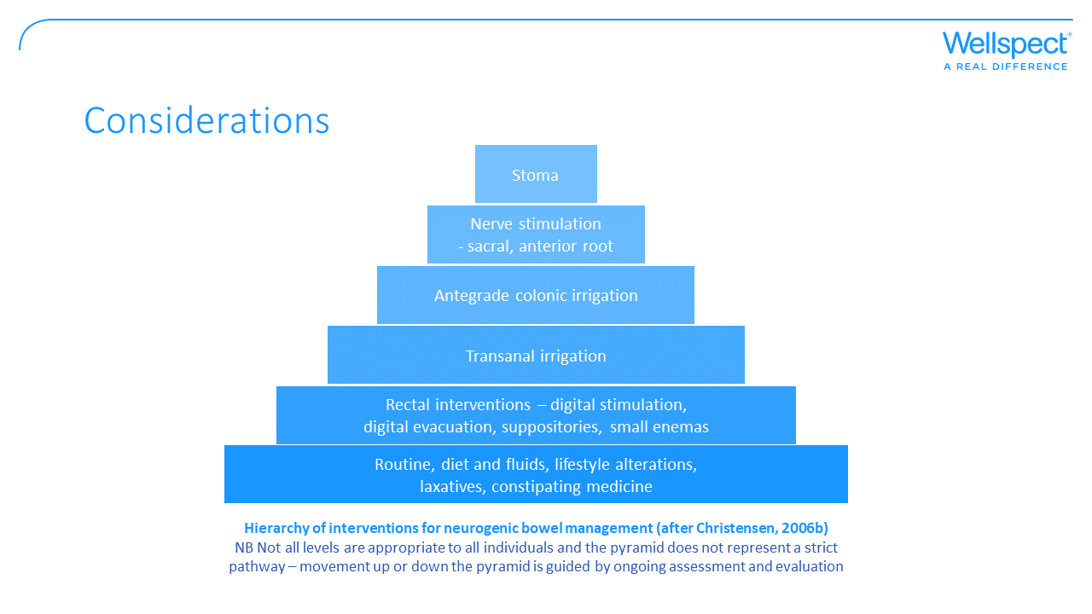

Slide 29
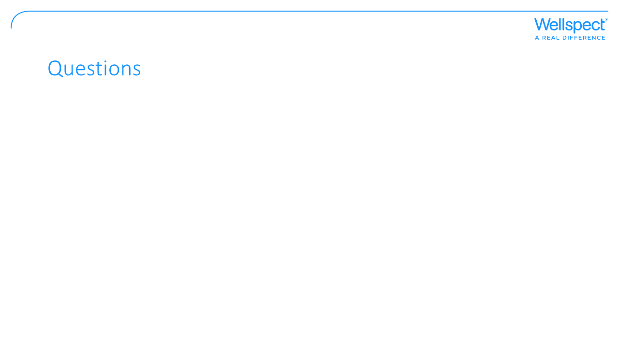

Slide 30


